Slide 1



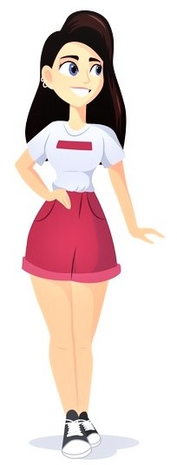
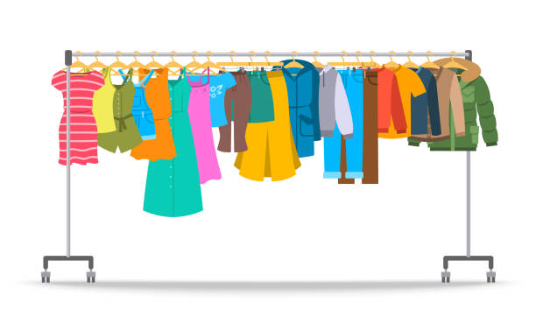
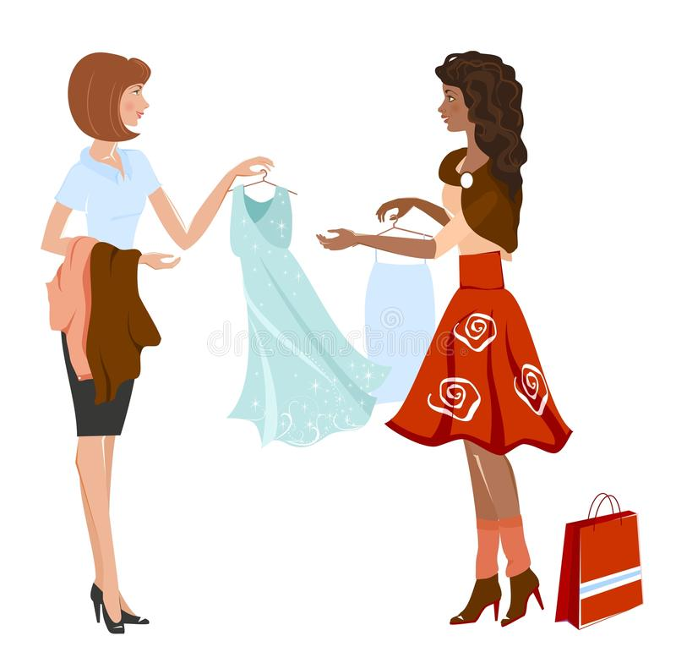
Solution breakthrough
Web/App based secured GUI
Taking user’s photo from webcam as input
Taking accurate body measurements of user
Output image with the chosen dress
Choosing garment from a cloud database
Size recommendation along with cloth recommendation according
to skin tone

Slide 2
Size recommender mechanism
Capturing image/uploading photo by the user
Taking body size measurements as input from user
Size Recommendation using a recommender system

Slide 3
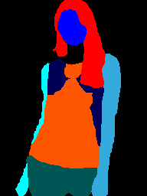
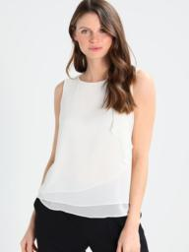
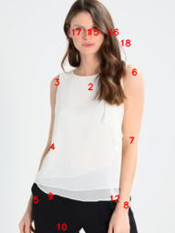
Virtual try-on
Segmentation of user’s body
(parsing)
JPPNet
Model
Goes to CPVTON+
User’s image
Pose estimation

Slide 4
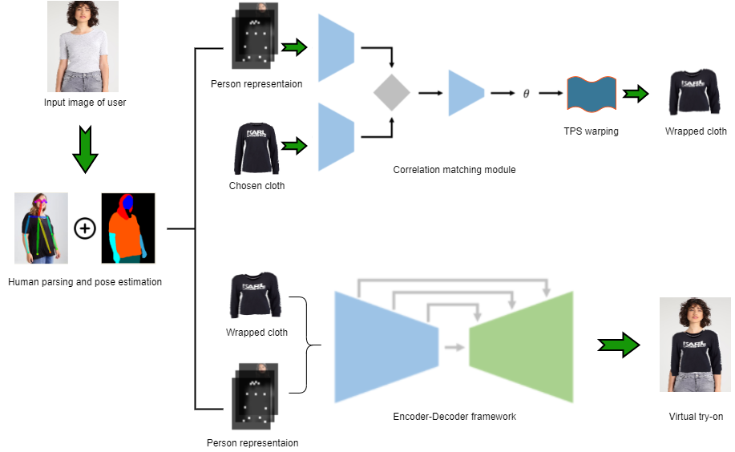
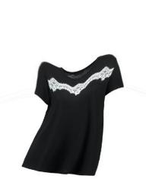
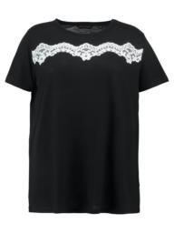
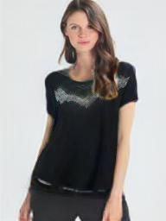

Slide 5
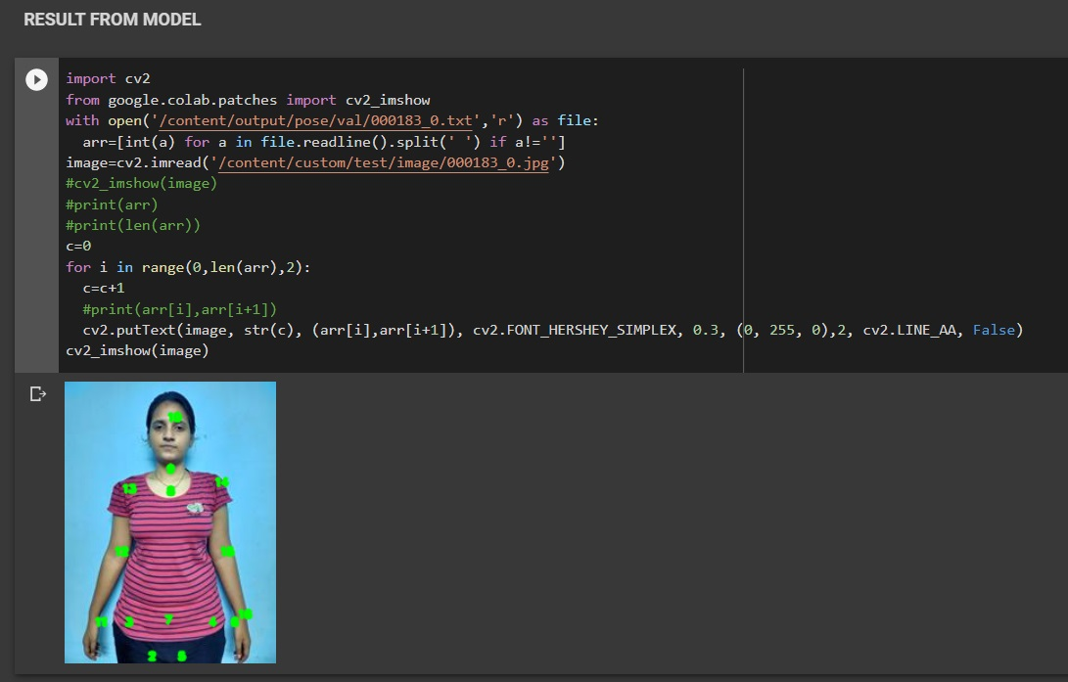
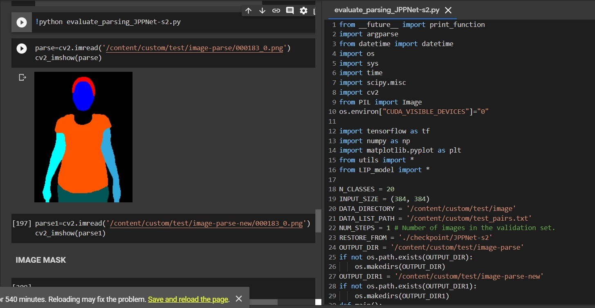
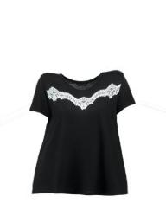
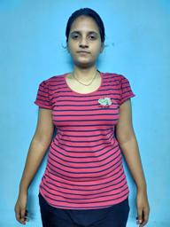
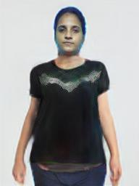
Virtual try-on results

Slide 6
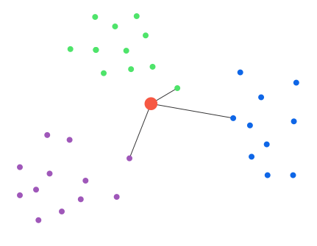
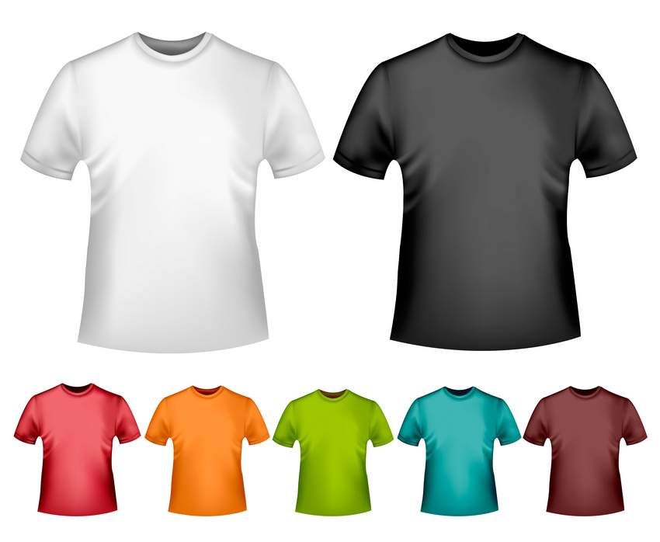
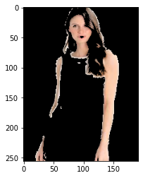
Cloth recommendation based on skin tone of user
Skin-tone detection
module
K-means clustering of 1st five dominant skin tones of user
Cloth recommendation according to skin tone of user
Skin tone recognition

Slide 7
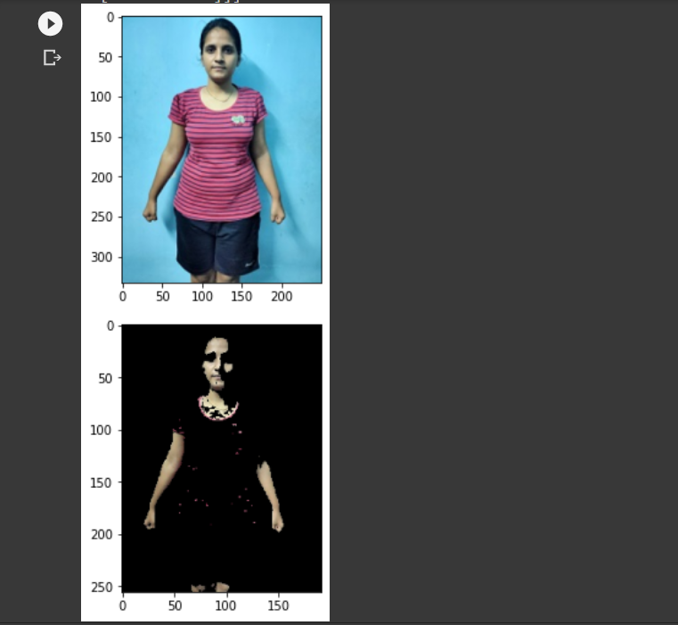
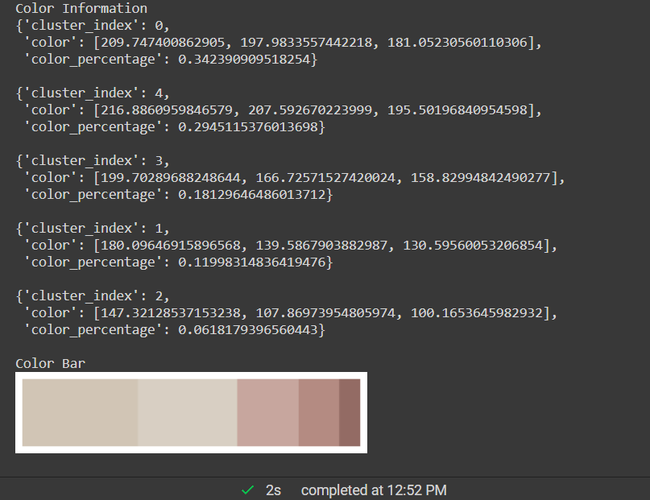
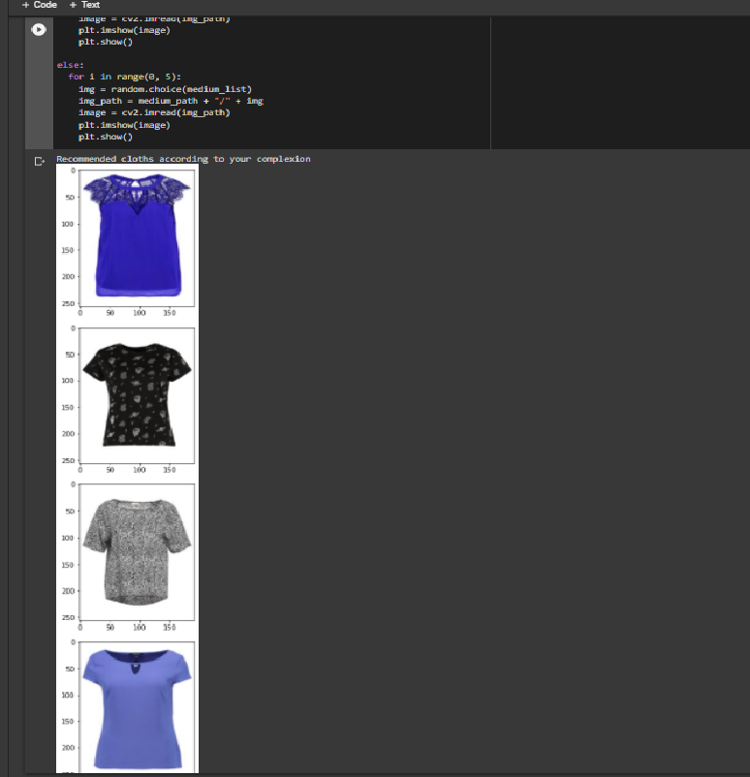
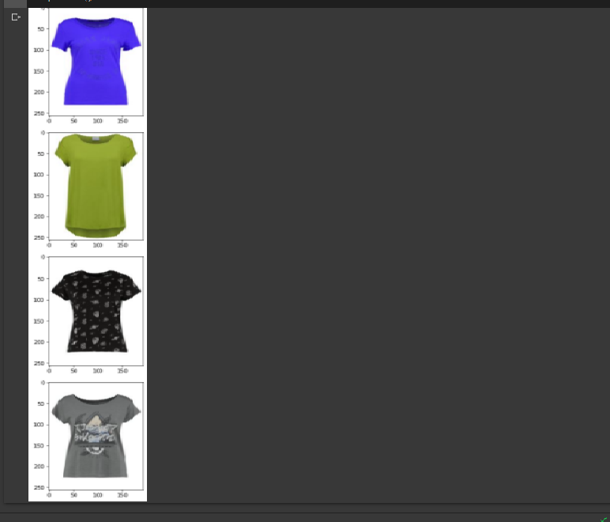
Skin detection
Skin tone recognition
Recommended cloths based on skin tone

